Slide 1
Reflections on Day-to-day Products and their Emotional Design

Slide 3
Emotional/Physical Experience of the World

Slide 4
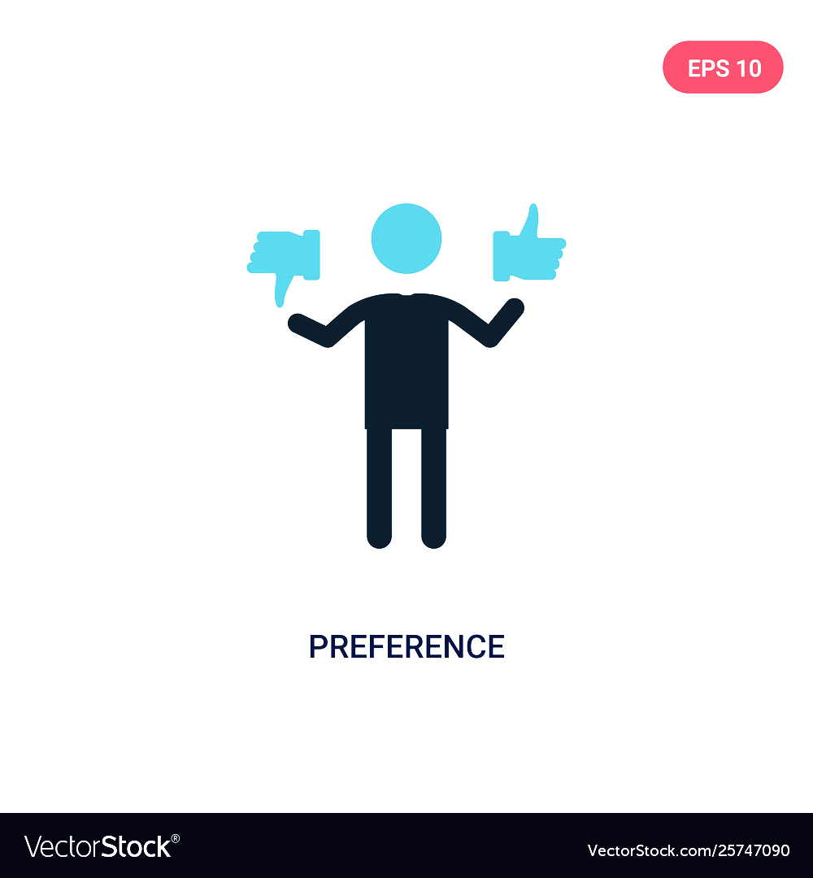
Preference : emotion and cognition

Slide 5
Not all creatures were made for art

Slide 6
Empirical Aesthetics (Fechner, 1876)
Size
Color
Balance
Shape
Regularity
Rhythm
Consonance
Proportion
Seeing with/without knowing

Slide 7
Expert vs. Non-expert Reaction
MEMORY
SUBJECTIVE

Slide 9
EMOTIONAL DESIGN

Slide 10
Cheap wine tastes better with…

Slide 11
Grandmother’s China Cup is valuable

Slide 12
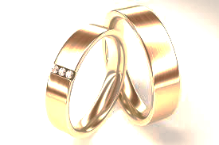
Objects carry negative/positive emotions

Slide 13
Aesthetic Objects are Emotive

Slide 14
Visceral Design

Slide 15
Behavioral Design

Slide 16
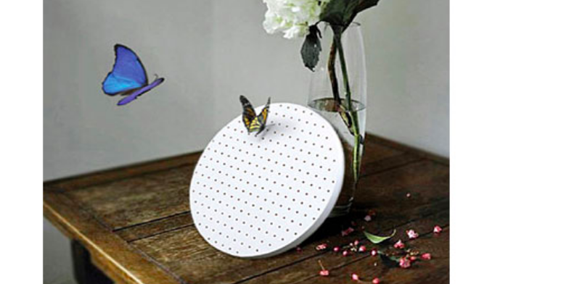
Behavioral Design

Slide 17
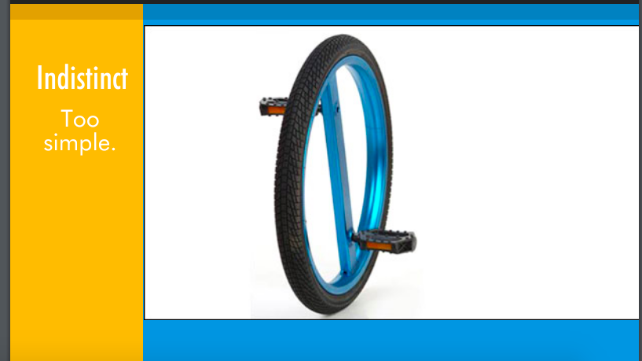

Slide 18
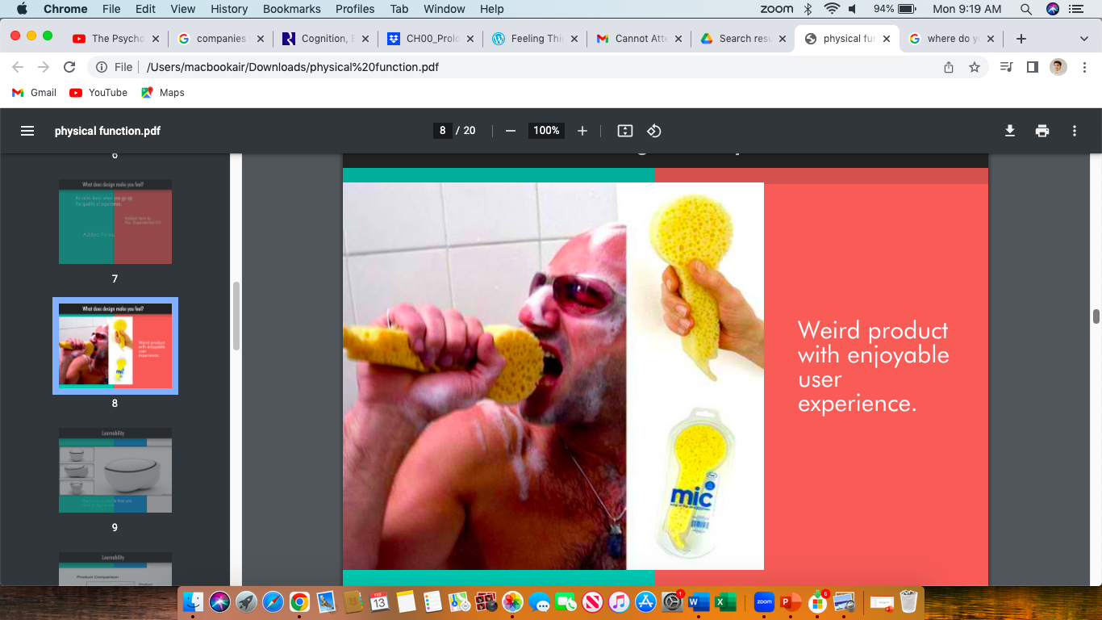

Slide 19
Reflective Design
Does it appeal to my self-image?

Slide 20
Describe the visceral, behavioral and reflective designs of this product.
How does it look to you?
Does it give you or others pleasure or effectiveness when using it?
Does it appeal to your self-image or others?

